Slide 1
Background, Customer Needs & Engineering Requirements
Team Red Feather: Nathan Fisher, Leann Hernandez, & Trevor Scott

Slide 2
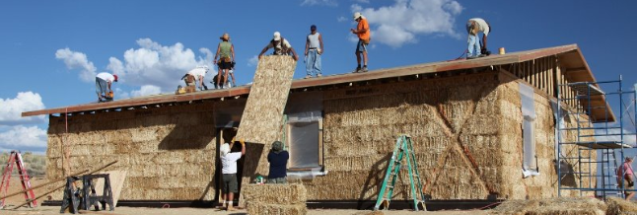
Background: Red Feather Development Group
Red Feather is a non-profit organization, develops sustainable solutions for the housing needs of the Navajo and Hopi Tribes
They repair and renovate homes for members of the Native American community.
They organize professionals, volunteers, and materials to address the needs of the Native American community.
Figure 1: Red Feather volunteers building straw homes [1].

Slide 3
Background: Solar Heater Project
The Navajo Generating Station (coal power plant) closed in November of 2019.
Residents of the local reservation were receiving coal for highly discounted prices prior to the power plant closing.
This coal was being burned to heat local residents’ homes, along with wood.
The price of coal has since increased greatly now that the power plant has closed.
Burning coal in your home poses respiratory health risks.
Other forms of heat (i.e. space heaters) are not practical due to high risk of fires.
Solar heaters are renewable and inexpensive long term.

Slide 4
Customer Needs
Low cost; cheapest commercial option is $750.
Needs to heat an entire home.
Must be scalable for different size homes
Needs to be built with standard power tools and welding equipment.
Low weight, needs to be installable by 2 people.
Must be durable.
Low noise level.
Wall or roof mountable.
Needs heat storage capability.

Slide 5
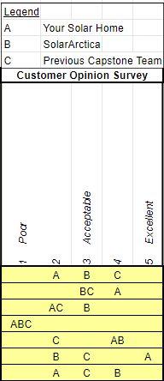
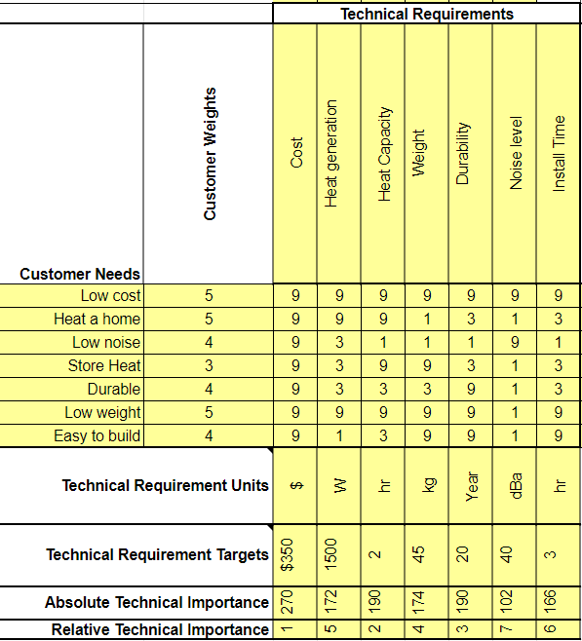
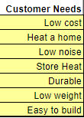
QFD

Slide 6
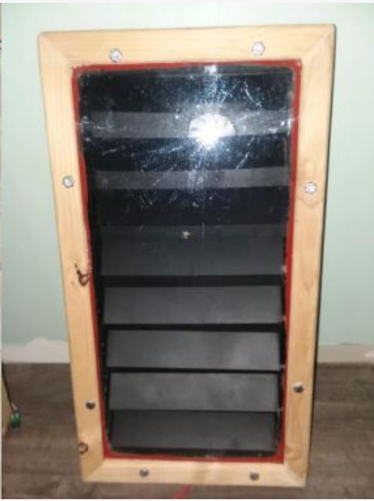
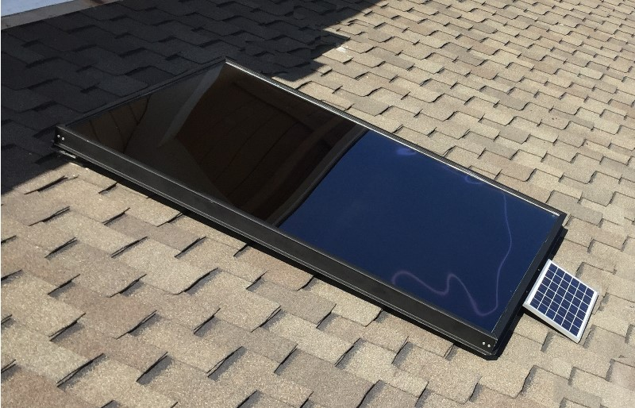
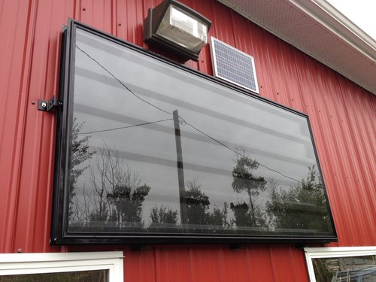
Benchmarking
Solar Artica 1500 Series
$750
1500W
Previous Capstone
$950
5000 W
Your Solar Home 1500GS
$1800
6000W

Slide 7
Engineering Requirements
Cost no more than $750
Produce at least 1500 W of heat
Provide heat for at least 2 hours past sunset
Must weigh under 45 kg
Last at least 20 years
Noise level under 40 dBa
The install time must be under 3 hours

Slide 8
References
[1] Red Feather Development Group, 2019. [Online]. Available: redfeather.org. [Accessed: 2 February 2020].
[2] Arctica Solar Fully Integrated Solar Air Heater - 1500 Series. Arctica Solar, 2019. [Online]. Available: http://www.arcticasolar.com/product/1500_series_datasheet_v2.pdf. [Accessed: 2 February 2020]
[3] SolarSheat 1500GS. Your Solar Home Inc. 2019. [Online]. Available:https://static1.squarespace. com/static/5272dc2ce4b0793e8f87f40d/t/528cc5cfe4b06e6e83ebe65d/1384957391688/1500GS_S pecs.pdf. [Accessed: 2 February 2020].
[4] Red Feather Thermal Energy for Homes. Northern Arizona University College of Engineering, Informatics, and Applied Sciences, 2019. [Online]. Available: https://www.cefns.nau.edu/capstone/projects/ME/2019/19S1_RedFeather/files/Final%20Poster.pdf

